Slide 1





Case Study #1 - Danny's Diner
Presented By: Gurjeet Singh Sodhi

Slide 2

Danny seriously loves Japanese food so in the beginning of 2021, he decides to embark upon a risky venture and opens up a cute little restaurant that sells his 3 favourite foods: sushi, curry and ramen. Danny’s Diner is in need of your assistance to help the restaurant stay afloat - the restaurant has captured some very basic data from their few months of operation but have no idea how to use their data to help them run the business.
Introduction

Slide 3
Danny wants to use the data to answer a few simple questions about his customers, especially about their visiting patterns, how much money they’ve spent and also which menu items are their favourite. Having this deeper connection with his customers will help him deliver a better and more personalised experience for his loyal customers. He plans on using these insights to help him decide whether he should expand the existing customer loyalty program - additionally he needs help to generate some basic datasets so his team can easily inspect the data without needing to use SQL. Danny has provided us with a sample of his overall customer data due to privacy issues - but he hopes that these examples are enough for you to write fully functioning SQL queries to help him answer his questions!
Problem Statement

Slide 4
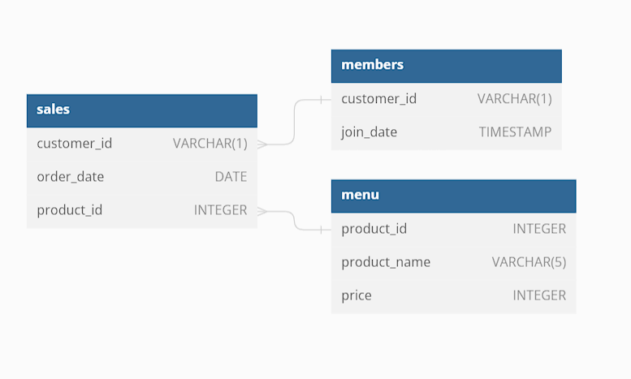
Danny has shared 3 key datasets for this case study:
Dataset
sales
menu
members
Entity Relationship Diagram

Slide 5
Case Study Questions
What is the total amount each customer spent at the restaurant?
How many days has each customer visited the restaurant?
What was the first item from the menu purchased by each customer?
What is the most purchased item on the menu and how many times was it purchased by all customers?
Which item was the most popular for each customer?
Which item was purchased first by the customer after they became a member?
Which item was purchased just before the customer became a member?
What is the total items and amount spent for each member before they became a member?
If each $1 spent equates to 10 points and sushi has a 2x points multiplier - how many points would each customer have?
In the first week after a customer joins the program (including their join date) they earn 2x points on all items, not just sushi - how many points do customer A and B have at the end of January?

Slide 6
Solution
I’m using Microsoft SQL Server and these are the functions used.
Aggregate functions — SUM, MIN, MAX
Numerical functions — TOP (WITH TIES)
Joins — Inner join, left join
Temp tables (CTE)
Windows function
Other Advanced functions- CAST, CASE STATEMENT
Let’s look at the individual solution to the problem statement.

Slide 7
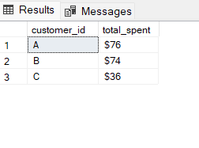
What is the total amount each customer spent at the restaurant?
SELECT s.customer_id,
'$'+ CAST(SUM(m.price) AS VARCHAR) AS total_spent
FROM sales AS s
INNER JOIN menu AS m
ON s.product_id = m.product_id
GROUP BY s.customer_id;

Slide 8
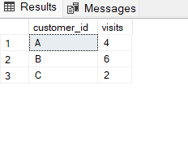
How many days has each customer visited the restaurant?
SELECT customer_id,
COUNT(DISTINCT(order_date)) AS visits
FROM sales
GROUP BY customer_id;

Slide 9
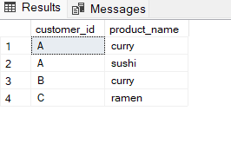
What was the first item from the menu purchased by each customer?
WITH first_item AS
(
SELECT s.customer_id,
m.product_name, [rank] = RANK() OVER(PARTITION BY customer_id ORDER BY s.order_date ASC)
FROM sales AS s
INNER JOIN menu AS m
ON s.product_id = m.product_id
)
SELECT customer_id, product_name
FROM first_item
WHERE [rank] = 1
GROUP BY customer_id, product_name;

Slide 10
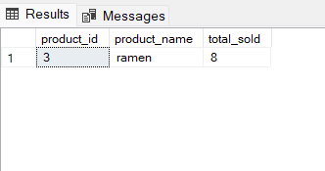
What is the most purchased item on the menu and how many times was it purchased by all customers?
SELECT TOP 1 s.product_id,
m.product_name,
COUNT(s.product_id) AS total_sold
FROM sales AS s
INNER JOIN menu AS m
ON s.product_id = m.product_id
GROUP BY s.product_id,m.product_name
ORDER BY total_sold DESC;

Slide 11
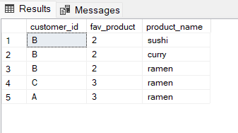
Which item was the most popular for each customer?
SELECT TOP 1 WITH TIES
s.customer_id,
COUNT(s.product_id) AS fav_product,
m.product_name
FROM sales AS s
INNER JOIN menu AS m
ON s.product_id = m.product_id
GROUP BY s.customer_id, m.product_name
ORDER BY DENSE_RANK() OVER(PARTITION BY customer_id ORDER BY COUNT(s.product_id) DESC);

Slide 12
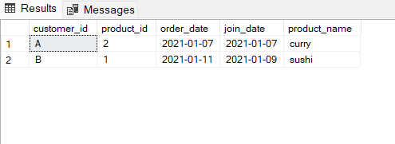
Which item was purchased first by the customer after they became a member?
SELECT TOP 1 WITH TIES s.customer_id,
s.product_id,
s.order_date,
m.join_date,
me.product_name
FROM sales AS s
INNER JOIN members AS m
ON s.customer_id = m.customer_id
INNER JOIN menu AS me
ON me.product_id = s.product_id
WHERE s.order_date >= m.join_date
ORDER BY RANK() OVER(PARTITION BY s.customer_id ORDER BY s.order_date ASC);

Slide 13
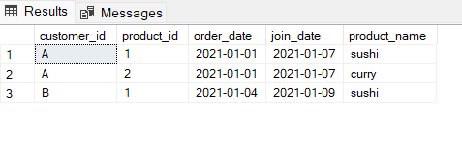
Which item was purchased just before the customer became a member?
SELECT TOP 1 WITH TIES s.customer_id,
s.product_id,
s.order_date,
m.join_date,
me.product_name
FROM sales AS s
INNER JOIN members AS m
ON s.customer_id = m.customer_id
INNER JOIN menu AS me
ON me.product_id = s.product_id
WHERE s.order_date >= m.join_date
ORDER BY RANK() OVER(PARTITION BY s.customer_id ORDER BY s.order_date ASC);

Slide 14
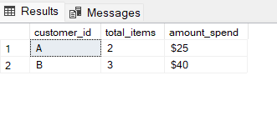
What is the total items and amount spent for each member before they became a member?
SELECT s.customer_id,
COUNT(me.product_name) AS total_items,
'$'+CAST(SUM (me.price) AS VARCHAR) AS amount_spend
FROM sales AS s
INNER JOIN members AS m
ON s.customer_id = m.customer_id
INNER JOIN menu AS me
ON me.product_id = s.product_id
WHERE s.order_date < m.join_date
GROUP BY s.customer_id;

Slide 15
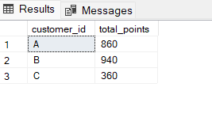
If each $1 spent equates to 10 points and sushi has a 2x points multiplier - how many points would each customer have?
SELECT
s.customer_id,
SUM(CASE
WHEN m.product_name = 'sushi’ THEN m.price * 20
ELSE m.price * 10
END) AS total_points
FROM sales AS s
INNER JOIN menu AS m
ON s.product_id = m.product_id
GROUP BY s.customer_id;

Slide 16
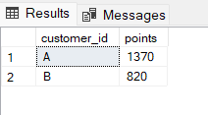
In the first week after a customer joins the program (including their join date) they earn 2x points on all items, not just sushi - how many points do customer A and B have at the end of January?
WITH dates AS (
SELECT *, DATEADD(DAY,6, join_date) AS first_week
FROM members
)
SELECT s.customer_id,
SUM(CASE WHEN m.product_name = 'sushi' THEN m.price * 20
WHEN s.order_date BETWEEN join_date AND first_week THEN m.price * 20
ELSE m.price * 10 END) AS points
FROM dates AS dt
LEFT JOIN sales AS s
ON dt.customer_id = s.customer_id
INNER JOIN menu AS m
ON s.product_id = m.product_id
WHERE s.order_date < CAST( '2021-02-01' AS DATE)
GROUP BY s.customer_id;

Slide 17
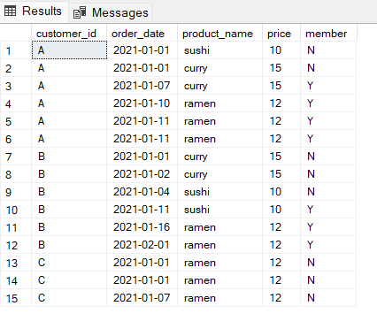
Join All The Things
Bonus Questions
SELECT s.customer_id,
s.order_date,
me.product_name,
me.price,
(CASE
WHEN m.join_date > s.order_date THEN 'N’
WHEN m.join_date IS NULL THEN 'N’
ELSE 'Y'
END) AS member
FROM sales AS s
LEFT JOIN members AS m
ON s.customer_id = m.customer_id
INNER JOIN menu AS me
ON me.product_id = s.product_id;

Slide 18
Rank All The Things
Bonus Questions
WITH ranking_cte AS (
SELECT s.customer_id,
s.order_date,
me.product_name,
me.price,
(CASE
WHEN m.join_date > s.order_date THEN 'N'
WHEN m.join_date IS NULL THEN 'N'
ELSE 'Y' END) AS member
FROM sales AS s
LEFT JOIN members AS m
ON s.customer_id = m.customer_id
INNER JOIN menu AS me
ON me.product_id = s.product_id
)
SELECT customer_id,
order_date,
product_name,
price,
member,
(CASE
WHEN member = 'N' THEN NULL
ELSE RANK() OVER (PARTITION BY customer_id,member ORDER BY order_date ASC)
END)AS ranking
FROM ranking_cte;

Slide 19
Key Insights
Total amount spent by A is $76, for B it is $74 and C spent $36
B is the most frequent visitor among all the Customers
Ramen is the most ordered food item
Before they became members, both Customers A and B spent $25 and $40 respectively
Total points for Customer A, B and C are 860, 940 and 360 respectively
Thank You !

